Slide 1
INF10025
Data Management and Analytics
Introduction to Unit

Slide 2
Unit Diagram
Unit Content
DBMS Basic Tools and Concepts
Queries/SQL
Data Modelling/ERD
Bus. Intell.
Cloud
Services Emerging uses of Databases
Unit Assessment (Portfolio)
Online Tests
Tasks
Outcome
Skills in explaining, using, applying, and designing databases
Learning Summary
Transactions
Normalisation
NoSQL

Slide 3
Unit Assessment
Portfolio unit
- No exam
Requirements for
- Pass
- Credit
- Distinction
- High Distinction
See Canvas > Unit Assessment for more specifics on the above

Slide 4
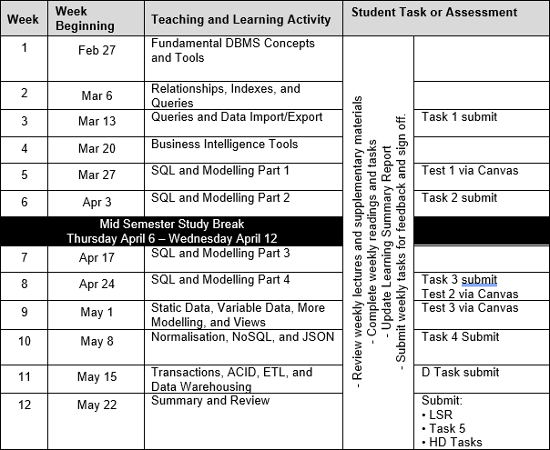
Unit
Schedule

Slide 5
Unit Tools and Techniques
Microsoft Access
Microsoft Power BI
SQL and iSQLJr (Oracle)
ERD Modelling (and Microsoft Visio, Draw i.0)

Slide 6
Communications
Large student body.
Canvas announcements.
Questions:
  Contact your tutor first.
  Best method of communication is by email.
  Tutor will refer issue to Convenor if required.

